Slide 1

Getting started with Angular 5 with Visual Studio Code
ISEP April 2018
Sérgio Azevedo
Senior Software Engineer
Rui Silva
Software Engineer

Slide 2






Slide 3


Who are we?
Senior Software Engineer @Devscope
sergio.azevedo@devscope.net
linkedin.com/in/sltazevedo
@thylux
Sérgio Azevedo
Notes:
Interested in all things integration – which of course includes MS Flow

Slide 4

Who are we?
Web & .Net Developer @Devscope
rui.silva@devscope.net
linkedin.com/in/ruisilva450
@ruisilva450
Rui Silva
Notes:
Interested in all things integration – which of course includes MS Flow

Slide 5
Agenda
Introduction to Angular
Hands-on: a simple Angular CRUD (create, read, update, delete) application demonstrating components, services, forms and REST services will be created

Slide 6
What is Angular?
HTML/CSS/JS based Application Framework
Cross Platform – web application, desktop applications (Electron, ...) and native applications (Ionic, NativeScript, …)
Speed and Performance – code generation, tree shaking, code splitting
Productivity – templates, CLI, IDEs
Full Development Story – testing, animations, accessibility
Extensive Documentation - https://angular.io/

Slide 7
Application Framework
Angular is more than a user interface (UI) library (such as React)
Angular is a complete framework for building the UI layer of many kinds of applications including web applications, desktop applications and even native applications
Angular organizes code through modules, provides UI widgets through components, formats data with pipes, manipulates the DOM through directives, provides access to REST services through the HTTP module, enhances HTML forms, application routing, etc…

Slide 8
Component Driven Development
The most important aspect of Angular is Component Driven Development
Components are a way to implement Separation of Concerns for frontend development
Understanding Component Driven Development is by far the most important part of learning Angular

Slide 9
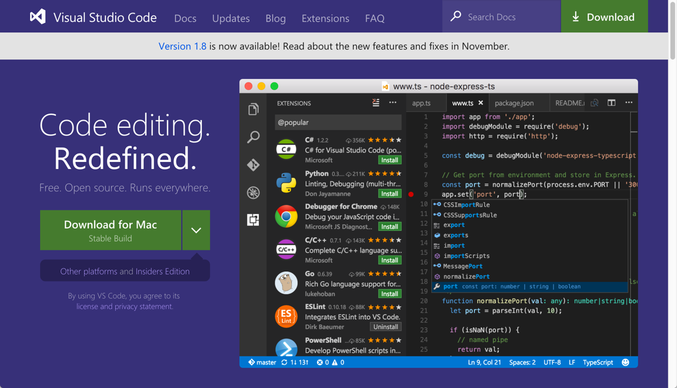
Visual Studio Code
Visual Studio Code is among the most popular editors for coding JavaScript applications
VS Code itself is an Electron-based editor coded with Chromium and Node.js using HTML/CSS/JavaScript
VS Code is an open-source project
http://code.visualstudio.com (runs on Windows, MacOS & Linux)

Slide 10
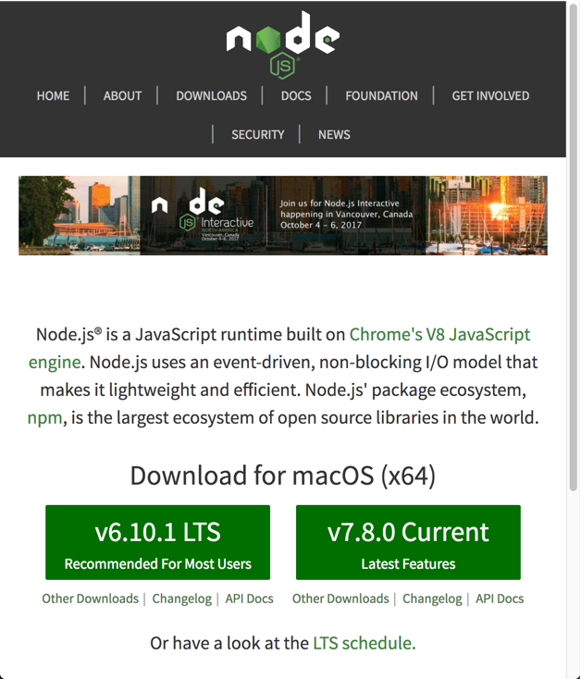
Node.js and NPM
Node.js is server-side JavaScript
Node.js and its package manager, NPM, are used to manage the JavaScript packages needed for the development tool chain including Angular itself

Slide 11
Node.js and NPM
Angular and the application's JavaScript files are bundled with a tool named Webpack
When bundling the files, Webpack runs the files though specially configured loaders such as TypeScript to transpile the code
Webpack also provides the web development server
REST Services are provided by the JSON Server
Webpack and JSON Server are both built with Node.js and distributed via NPM

Slide 12
TypeScript
Angular is a JavaScript based framework
Angular can be coded with JavaScript but TypeScript is preferred
Languages such as TypeScript and Dart transpile their code to JavaScript which is then executed by the browser
The Angular documentation supports TypeScript and JavaScript for doing Angular development
The preferred language is TypeScript, and this course will be taught with TypeScript

Slide 13
TypeScript
TypeScript provides support for ES2015 (aka ES6) and Strong Typing
While most modern browsers now support most of ES2015, none of them support ES2015 modules which is key to Angular development
TypeScript will provide ES2015 modules for all browsers, and support for ES2015 in general for older browsers
TypeScript brings strong-typing to the loosely-typed JavaScript language
Strong-typing supports JavaScript at the enterprise level

Slide 14
SASS
SASS will be used transpile all CSS code in the Angular application
There are two kinds of SASS files
Web Page SASS – produces the application's global stylesheet
Component SASS – produces a component's stylesheet following Web Components CSS standards
Through the use of WebPack, SASS will be loaded, transpiled and added to the JavaScript bundle through the use of import and require statements in the TypeScript code

Slide 15
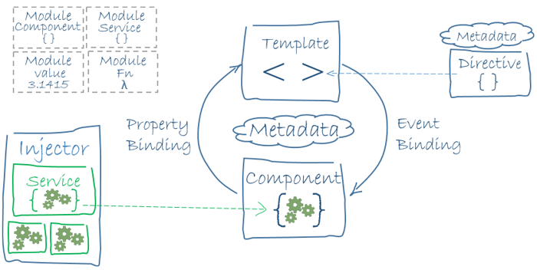
Architecture Overview

Slide 16
Angular: Hello World!
Demonstrates many of the essential elements of an Angular application
App Module – modules contain the custom parts of an Angular application such as custom components and pipes
App Component – components contain the user interface template and user interaction logic, components can be composed with components to build larger components
Main – starting point of the application, loads the App Module, and bootstraps it

Slide 17
Two Module Systems
Two module systems are used to build Angular applications:
ES2015
Angular
ES2015 Modules are provided by JavaScript, one file is one module, and one module is one file
Angular modules can span many files and organize the various parts of an Angular application

Slide 18
ES2015 Modules
Originally, JavaScript did not support the usual structures for building large applications such as namespaces or modules
Over the course of time, several patterns emerged for organizing applications into modules: AMD (asynchronous module definition) and CommonJS
Most developers know of AMD through one of its popular implementations Require.js; and CommonJS is used by Node.js
While both module systems are still used today, the JavaScript specification (ES2015) now has support for modules which will be referred to as ES2015 Modules

Slide 19
ES2015 Modules
Through the use of Babel and Webpack, ES2015 Modules are available to developers
When Angular is installed in the application via NPM, it can be easily imported using the import syntax of ES2015 modules
An application grows with numerous component and other classes, each class receives its own file, and can be imported by other files if the class is marked with the export keyword

Slide 20
Angular Modules
Modules are JavaScript classes decorated with NgModule
NgModule is imported from Angular Core
There are several options which can be configured
imports – includes dependent modules
declarations – includes components, directives and pipes
bootstrap – bootstraps the Angular application with the specified component, typically this is AppComponent
providers – register services for dependency injection

Slide 21
Angular Components
JavaScript class decorated with the Component decorator
Component decorator is imported from Angular Core
The Component decorator supports many options
selector – the CSS selector the component will use as a marker in the DOM to know where to place the component
templateUrl – URL points to the file containing the HTML template
styleUrls – URL pointing to various CSS stylesheets

Slide 22
Composing Angular Components
In addition to managing component data, the other critical concept of working with components is how to compose them
While a single Angular component can contain the entire UI, this is not a best practice
Instead, large UIs should be decomposed into many smaller components, which are then composed together to form a larger UI
The flow of data between parent and child components is critical:
Parent passes data to child component via inputs; data should be immutable to child
Child passes data to parent via outputs; data is used to update the state of the parent, or is passed up the component tree

Slide 23

Composing Angular Components
This is the most important concept of Component Driven Development as it
applies to all modern component based frameworks/libraries such as Angular
Parent Component
Input Properties
Output Events
Input Properties are typically data values and event handler. The child component receives the parent data input, and uses the parent event handlers to communicate data to the parent
Events from within the child invoke the event handlers from the parent. The child passes data to the parent through arguments passed to the event handler when invoked
Child Component

Slide 24
Angular Services
Among JavaScript libraries and frameworks, dependency injection is something unique to Angular
The configuration can be a little tricky, especially when overriding default configurations within a hierarchy
Among the many benefits is the ability to change implementations of a service without having to rewrite a lot of code, and the ability to replace concrete instances with mocked versions when unit testing, etc…

Slide 25
Creating a Service
Services can be created from classes or from values
In this section, the focus is on classes, values will be discussed later
To create a service with a class all that is need is to define the class, register it with the Angular part, then inject it via the constructor
The class is coded as nothing more than a regular JavaScript class, nothing more is needed

Slide 26
Creating a Service
Services must be registered via the providers option
Each Angular part which will use the service does not need to register it, but it must be registered at the module level for all parts in the module to use it
In the case of the component tree, if the service is not registered in the module, it must be registered in the component (or a parent component of the component) which desires to use it
When creating a service with a class, the class simply needs to be listed in the providers array

Slide 27
Creating a Service
Example of Module Registration
Example of Component Registration
@NgModule({
imports: [ BrowserModule ],
declarations: [ AppComponent ],
bootstrap: [ AppComponent ],
providers: [ SomeService ],
})
export class AppModule { }
@Component({
selector: "widget-tool",
template: require("./app.component.html"),
styles: [ require("./app.component.scss") ],
providers: [ SomeService ],
})
export class AppComponent { }

Slide 28
Hands-on Labs

Slide 29
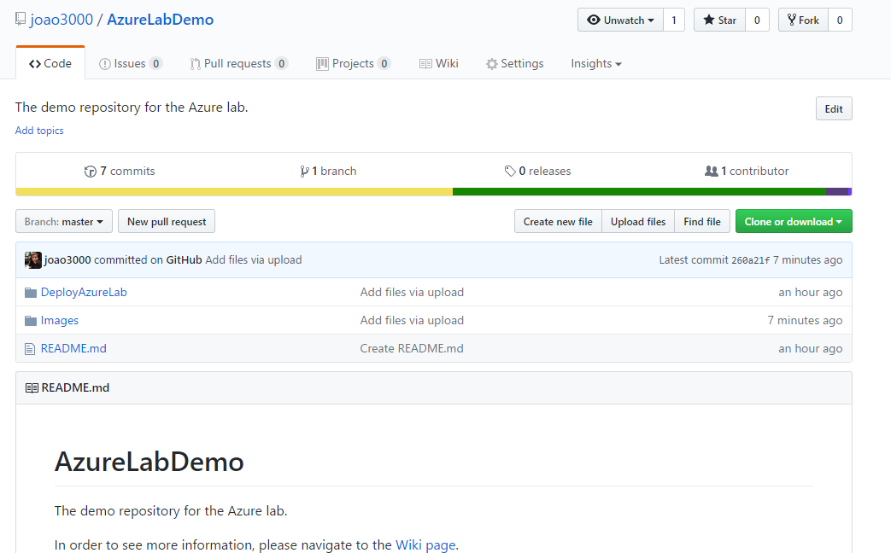
Hands-on Labs

Slide 30
Rua Passos Manuel Nº 223 – 3º Andar
4000-385 Porto
T. +351 223 751 350/51
F. +351 223 751 352
info@devscope.net
www.devscope.net

